Slide 1
High School Science Q&A Chatbot: A Hybrid IRQA–RAG Approach with an Open-Source LLMs (part 2: run on your own chatbot.)
Gyeongmo Min, Junehee Yoo
Department of Physics Education, Seoul National University
Notes:
Hello, everyone. Thank you for inviting me today. I am very honored to speak at Plovdiv University.
I want to introduce myself first. I am a high school teacher in Korea — teaching 12th-grade students. As you know, teaching 12th graders is a very busy job. And I am an instructor at Seoul National University.
Today’s lecture will be focused on interactive hands-on activities.

Slide 2
Introduction
A science teacher’s worries about AI chatbots
Cost: Public schools do not have enough money to pay for commercial AI services.
Privacy: We must protect student data. It’s necessary that students’ information do not flow to the public.
The Danger of AI Agents: If AI chatbots just give the final answer, students stop thinking for themselves.
AI agent solves complex problems automatically.
The AI does ALL the thinking.
Students just wait for the answer.
Reasoning process is invisible.
Student thinking is replaced, not supported.
We need an AI that acts as a 'Guide', not a 'Problem Solver'.
Notes:
As a teacher, I see many students using AI chatbots like ChatGPT.
But using commercial AI chatbots in public schools is difficult:
These three worries shaped every decision in our research.
Recently, smart 'AI Agents' are very popular. They can solve complex problems automatically.
But for simple high school science questions, this is dangerous.
The AI does the thinking, not the student.
We need an AI that acts as a 'Guide', not a 'Problem Solver'.

Slide 3
Two Core Technologies for hybrid approach
RAG (Retrieval-Augmented Generation) for grounded answers
AI reads contexts about students’ question before answering.
Contexts:
4 pairs of the actual students’ questions and teacher’s answers.
6 corpuses of the actual science textbooks.
Benefits: It answers based on Q&A pairs and the textbooks. So it reduces hallucination.
IRQA (Information Retrieval Q&A) for peer learning
System searches past student questions and shows similar Q&A pairs.
Benefits: Like reading a friend's study notes, students feel they are not studying alone by showing actual students’ Q&A pairs.
Notes:
For example, student asks about photosynthesis → AI finds relevant Q&A pairs made from students’ real questions and the corpuses in the textbook → It can give a safe, accurate answer.

Slide 4
Our Solution: A Hybrid Approach
To solve these real classroom problems, we made a new system.
No API costs using open-source LLM – like Google Gemma 3 12B.
Runs on a local school server – No student data leaves the school.
Hybrid system – RAG + IRQA for accurate answers and peer learning.
By applying these hybrid approach, AI chatbots can be a guide.
Provides relevant information only.
Students still have to think and decide. – Active thinking is facilitated.
LLM’s reasoning process is shown step-by-step.
Teachers can control chatbot’s answers with its dataset.

Slide 5
What we are going to do
Today, we are going to setup your chatbot running on your computer. – hands on activity
Yesterday, I ported my chatbot to Bulgarian, and uploaded customized educational chatbot template on GitHub to public.
I made a chatbot for integrated science education, but this template can be used for general purpose as well.
If you change dataset, you can make any chatbot which is be able to control almost on your favor, for free.

Slide 6

Chatbot demonstration
You can access our science Q&A chatbot which is translated into Bulgarian.
https://acer2.snu.ac.kr:8503 (I am running a temporary web server for this chatbot.)
You’ll get this chatbot from now on.

Slide 7
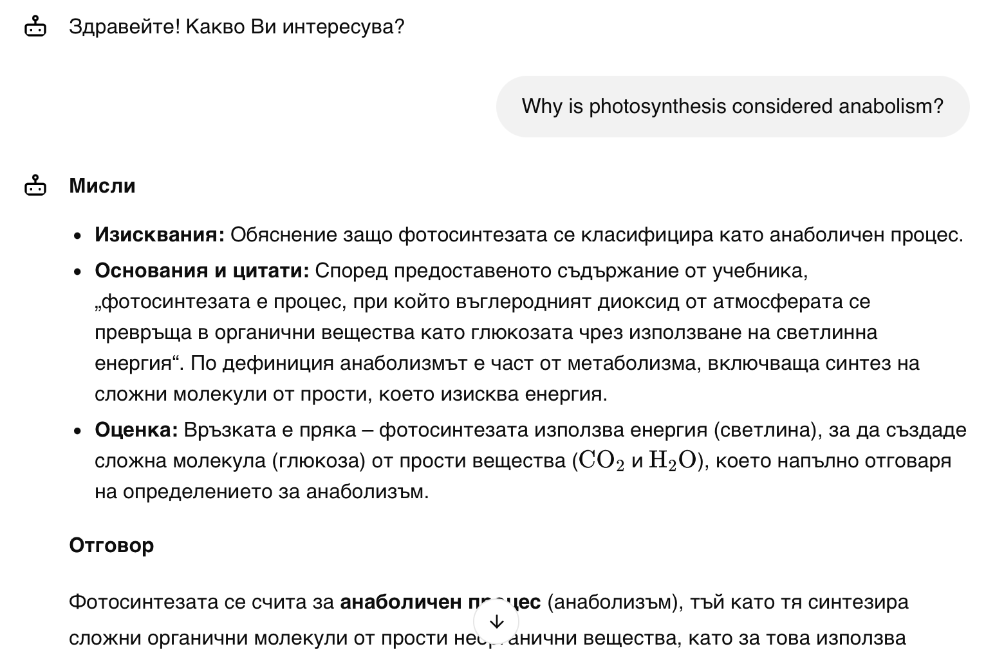
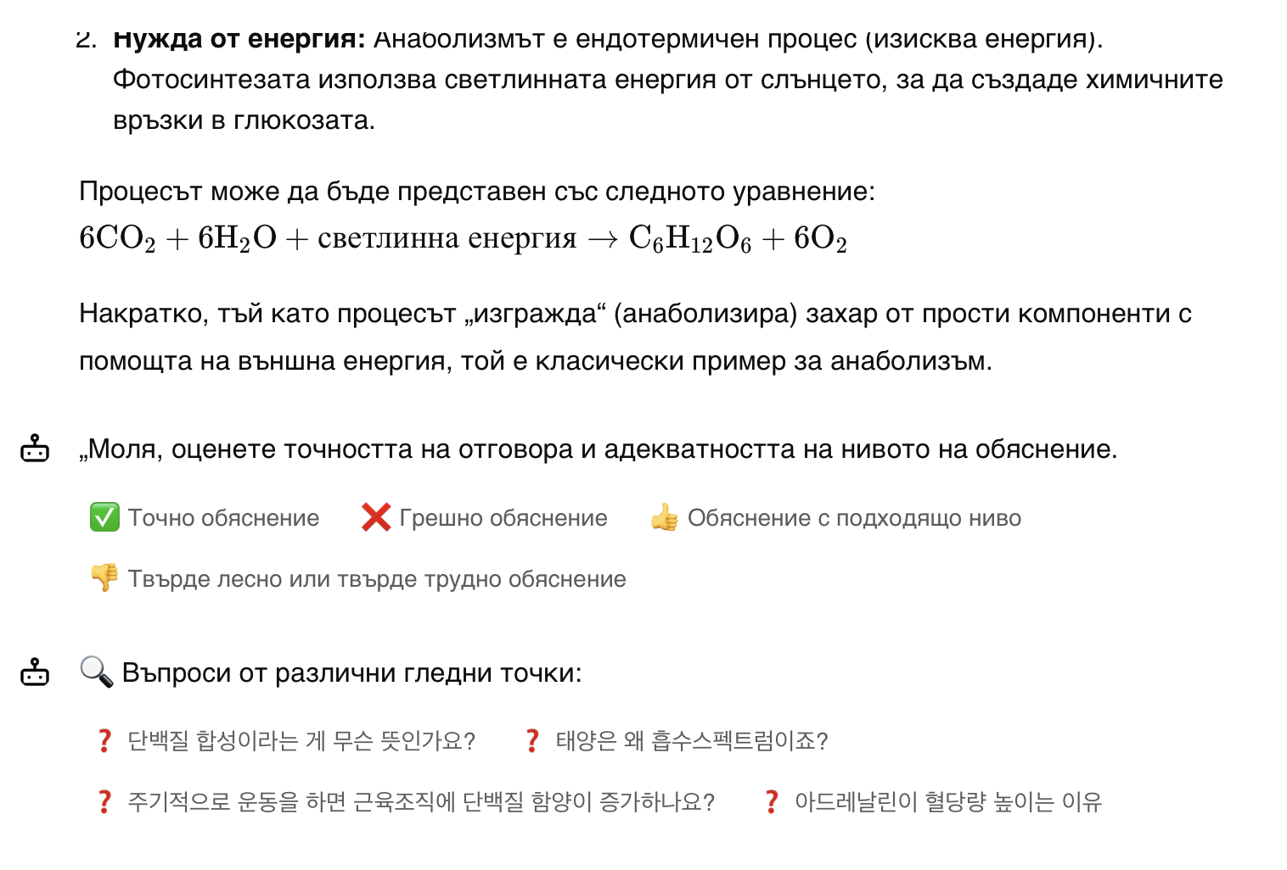
Notes:
(Please look at the screenshot)
This is what my students see on their phones.
A student asks: 'Why is photosynthesis considered anabolism?'
The AI explains it step-by-step.
Below, you see buttons suggesting other related questions.

Slide 8
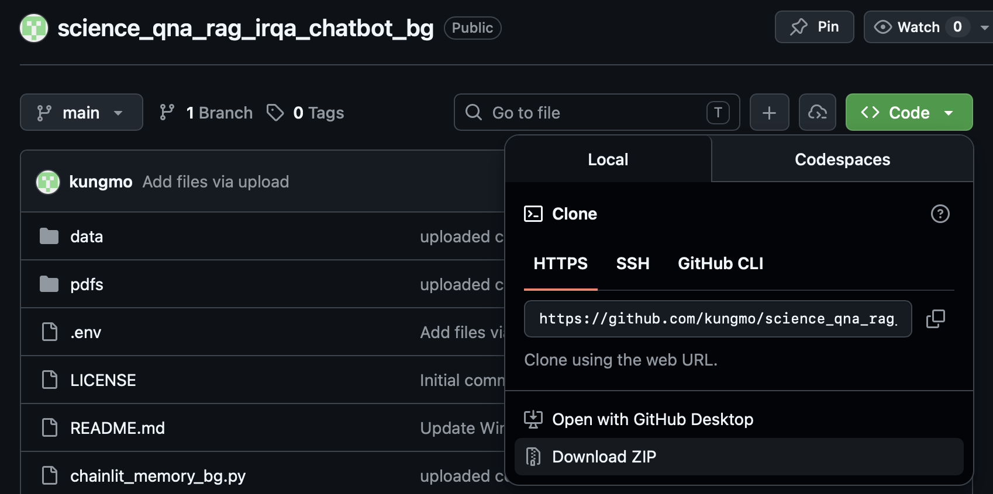
Download the template from GitHub
Open the web browser and go to the page below.
github.com/kungmo/science_qna_rag_irqa_chatbot_bg
Click a Code button
Click a Download ZIP button
Extract it to your Desktop

Slide 9
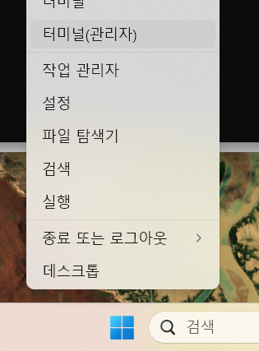
Install uv
2. Click Terminal
Before you proceed, uv must be installed on your computer.
uv is an extremely fast Python package and project manager.
We will install uv in CLI environment.
CLI: command line interface
Windows: Click the right button of
your mouse on the Start button
1. MacOS/Linux: Launch terminal

Slide 10
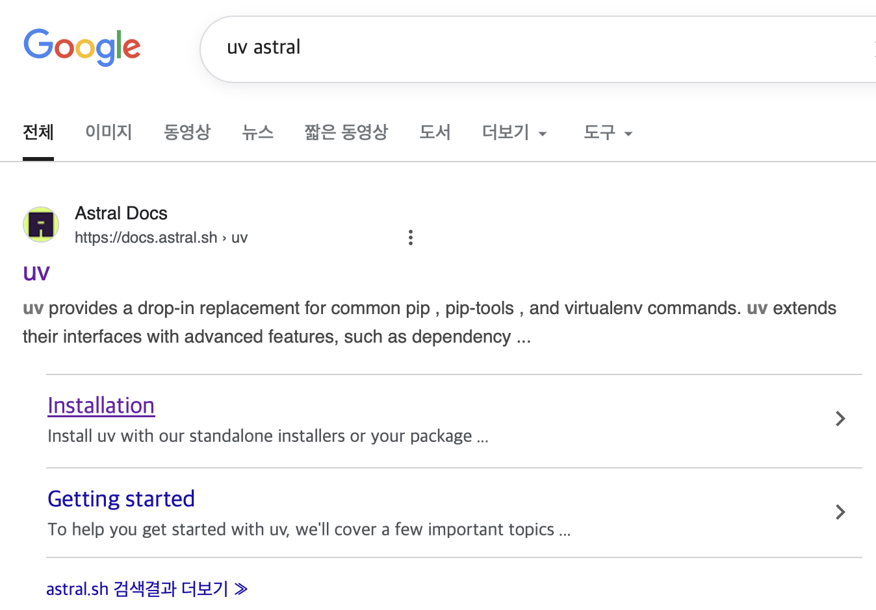
3. Search for 'uv astral' on Google and go to the installation page.

Slide 11
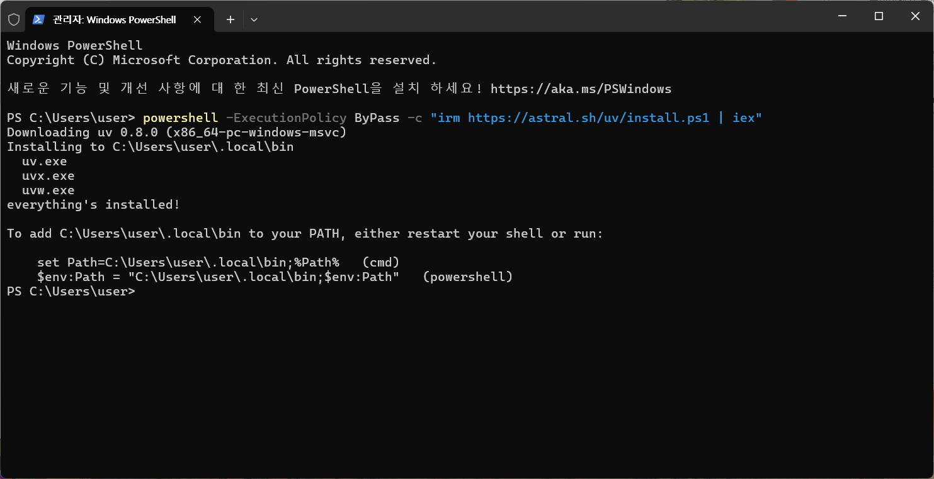
4. Copy and paste installation command of uv for Windows.

Slide 12
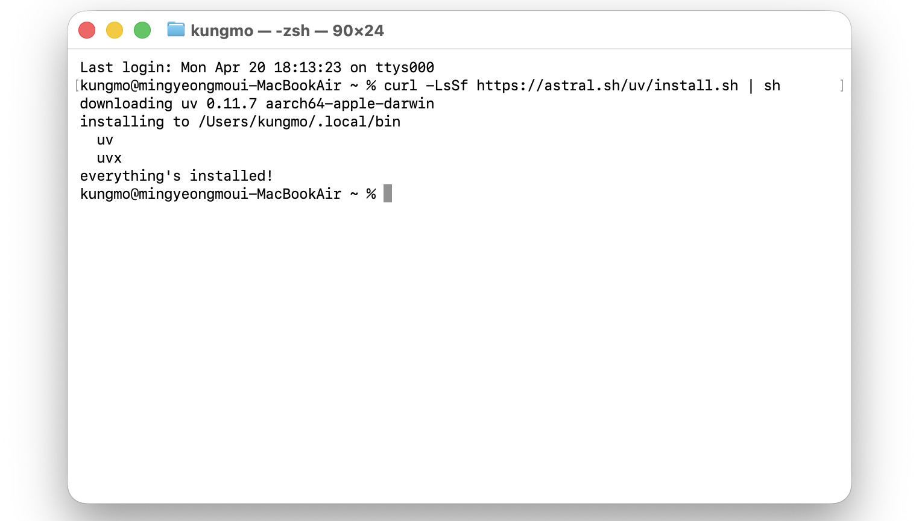
4. Copy and paste installation command of uv for MacOS.

Slide 13
Demonstration / Contacts
I’ll show remaining setup process step by step.
After you watch my procedure, you can do it anytime you want.
With the upgrades to the Bulgarian Sentence-BERT model and the open-source LLM for our vector store, the chatbot's performance will improve.
If it is not working in this class, call me.
When you encounter problems after this class during installation process, email me. (kungmo@snu.ac.kr)

Slide 14
References
Bulgarian Sentence-BERT model: https://huggingface.co/usmiva/bert-web-bg
Science Q&A chatbot template: https://github.com/kungmo/science_qna_rag_irqa_chatbot

